Slide 1
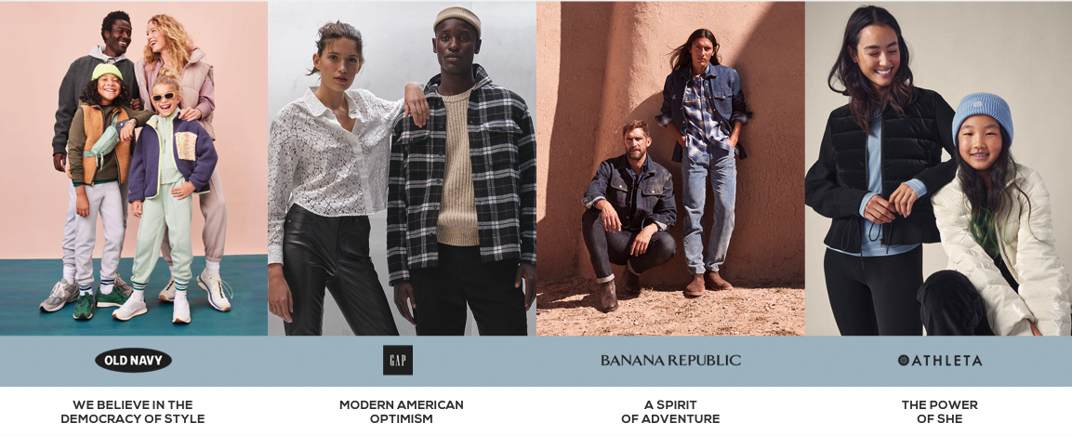

Uncovering Customer Sentiment for clothing brand GAP
Group 3
April 13, 2023

Slide 2


Slide 3
AGENDA
1
2
3
INTRODUCTION
RESEARCH OBJETIVES
RESEARCH METHODOLOGY
4
5
6
DATA ANALYSIS
RESULTS
RECOMMENDATIONS
CONCLUSIONS

Slide 4

1.Introduction

Slide 5
GAP is an American worldwide clothing and accessories retailer.
Gap was founded in 1969 in San Francisco.
Currently operates in over 40+ countries
GAP has ability to ship to 90 countries.
Gap, (the flagship brand), Banana Republic, Old Navy, and Athleta are the company's four core divisions.

Slide 6
Objectives

Slide 7

RESEARCH OBJECTIVES
Investigate the digital media presence of GAP.
Analyze customer opinions and sentiments related to GAP products and services
Identify trends and patterns in customer opinions and sentiments.
Provide practical recommendations for GAP to improve its digital media strategies and overall performance in over market.

Slide 8

RESEARCH OBJECTIVES - QUESTIONS
Q1. The trends and patterns identified in customer opinions and sentiments related to the brand GAP in social media.
Q2. Public Sentiments on social media (Instagram) comparing GAP Adults and GAP Kids.
Q3. The major topics of discussion in media about the rise and fall of GAP analyzing comments from YouTube.
Q4. The current state of GAP's digital media presence in the Canadian market by analyzing the web traffic.

Slide 9
Research Methodology

Slide 10


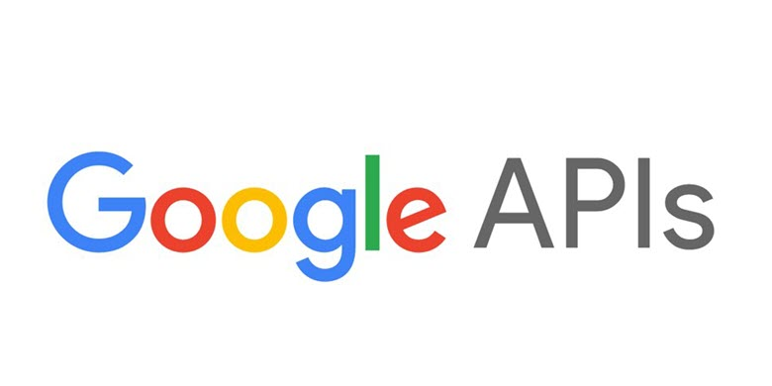








DATA EXTRACTION – TOOLS
1
TOOLS
ANALYSIS
FRAMEWORK
Word Frequency
Sentiment Analysis
Top Modeling and Sentiment Labeling
Python
InstagramAPI
Gensim
Top modelling for humans
2
DIGITAL MEDIA
PLATAFORM
SEO
Search Engine Optimization
Competitor’s
Visibility
API: Application Program Interface

Slide 11



DATA EXTRACTION – TOOLS
SOURCE
TOOLS
1
ANALYSIS
FRAMEWORK
+ 3MM
followers
Word Frequency
Sentiment Analysis
Top Modeling and Sentiment Labeling
SOCIAL MEDIA
Python
InstagramAPI
+ 1,200MM
views
Gensim
Top modelling for humans
2
DIGITAL MEDIA
PLATAFORM
WEBSITE
SEO
Search Engine Optimization
Competitor’s
Visibility

Slide 12


DATA ANALYSIS– WEB SCRAPING PROCESS
Python
1. Collect Data
2.Data Preparation
3. Data Clean
4. Data Transformation
5.Results
Word Frequency
Sentiment Analysis
Topic Modeling and Sentiment Labeling
InstagramAPI
Gensim
UNIQUE
DATA
RAW Data
"COMMENTS"
FINAL DATA

Slide 13
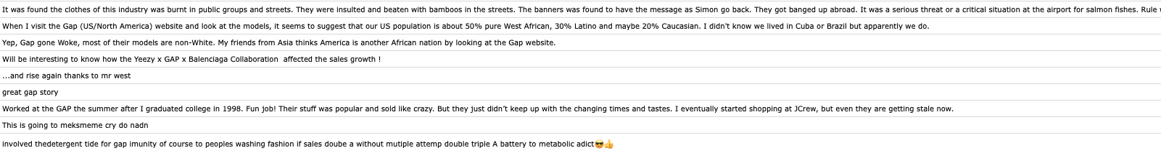
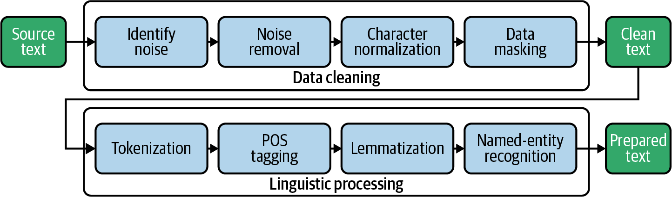
DATA CLEANING – Python Libraries
KEYWORD: GAP
Real comments from Social Media
One sentence
“great gap story”
Python Libraries
Three words
great + gap + story

Slide 14


DATA COLLECTION – TIME FRAME
4 Years
2019
2023

Slide 15
Data Analysis

Slide 16
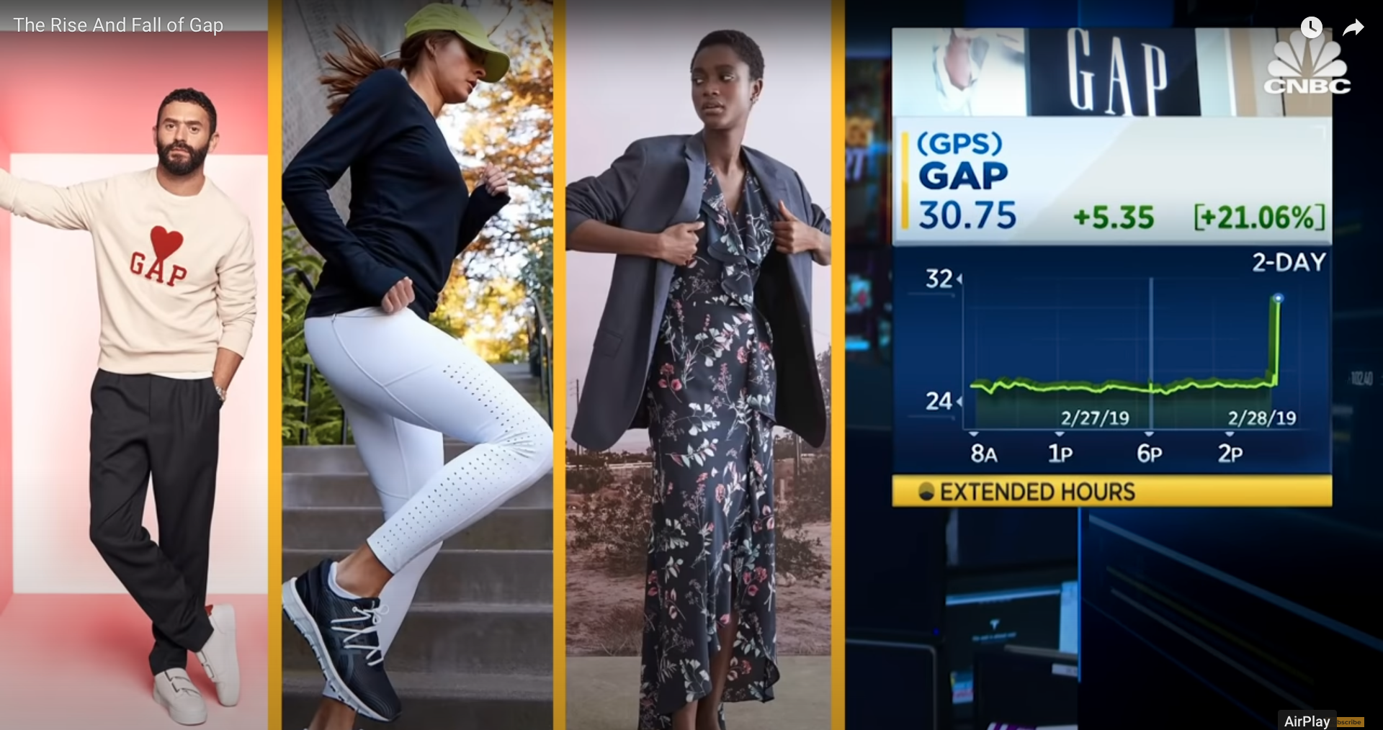
DATA ANALYSIS - Overview
Raw
comments
Cleaned
comments
Distinct Words
Total Words
Views
1,202,004
1,273
516
2,057
6,463
YouTube Video: The Rise And Fall of Gap

Slide 17
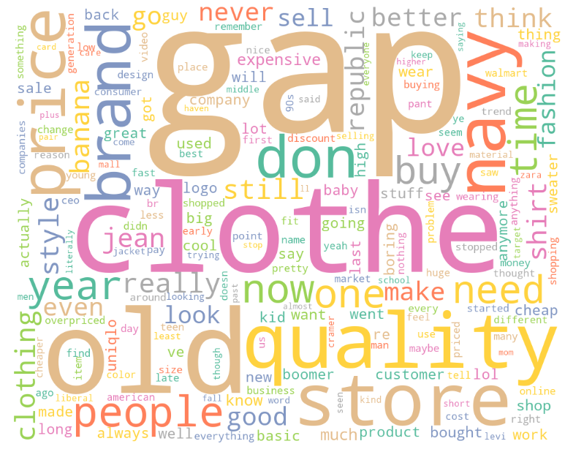
WORD FREQUENCY - YouTube
10 most frequent used words
Rank | Word | Frequency | Key Analysis
1 | gap | 635 | Brand Engagement & Awareness​
2 | old | 420 | Negative to neutral sentiment
3 | clothe | 400 | Neutral sentiment
4 | quality | 354 | Positive sentiment
5 | price | 340 | Neutral to negative sentiment
6 | store | 326 | Neutral sentiment
7 | navy | 298 | Brand Engagement & Awareness
8 | brand | 246 | Strong identity or reputation
9 | people | 192 | Neutral sentiment
10 | fashion | 122 | Trendy or stylish
6,463

Slide 18

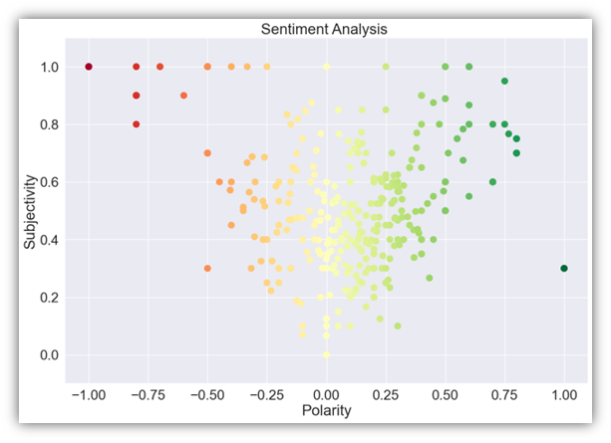
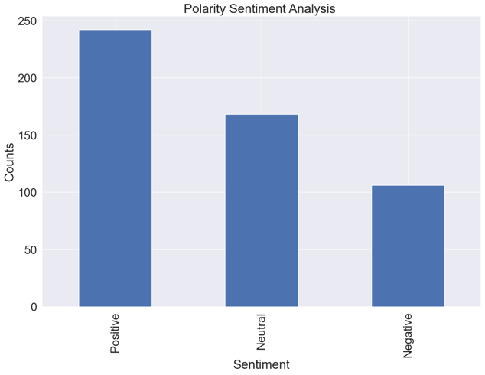
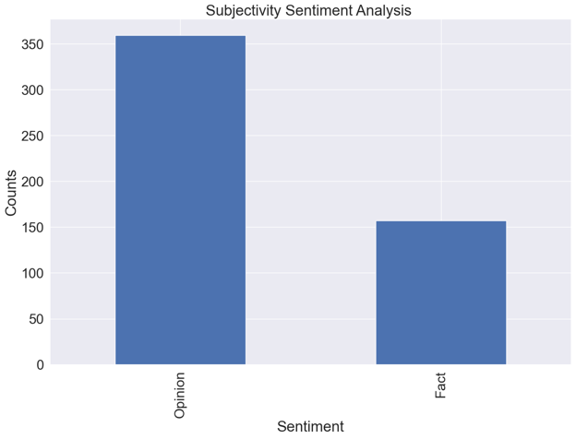
SENTIMENT ANALYSIS - YouTube
3 types used in this study:​
43%
70% opinions
Subjectivity float range: [0, 1]​
The Polarity float range: [-1, 1]
242 Positive 168 Neutral
106 Negative​
359 comments expressing opinions ​
157 comments expressing facts ​

Slide 19
GAP YouTube - SUMMARY
Target Audience Behavior
Despite of the fact that video was about the rise and fall of the GAP company, sentiments of the people towards the video was mostly positive.
Attract potential customers who are likely to be interested in their brands, GAP could use targeted advertising.
Public sentiments are positive even if the engagement metrics are low

Slide 20


DATA ANALYSIS – OVERVIEW
Posts
Raw
comments
Cleaned
comments
Distinct Words
Total Words
224
2,483
1,025
2,370
6,627
+ 3MM
followers
719
8,550
4,961
4,291
24,639
Source: GAP Social Media – Retrieved on April 05, 2023

Slide 21
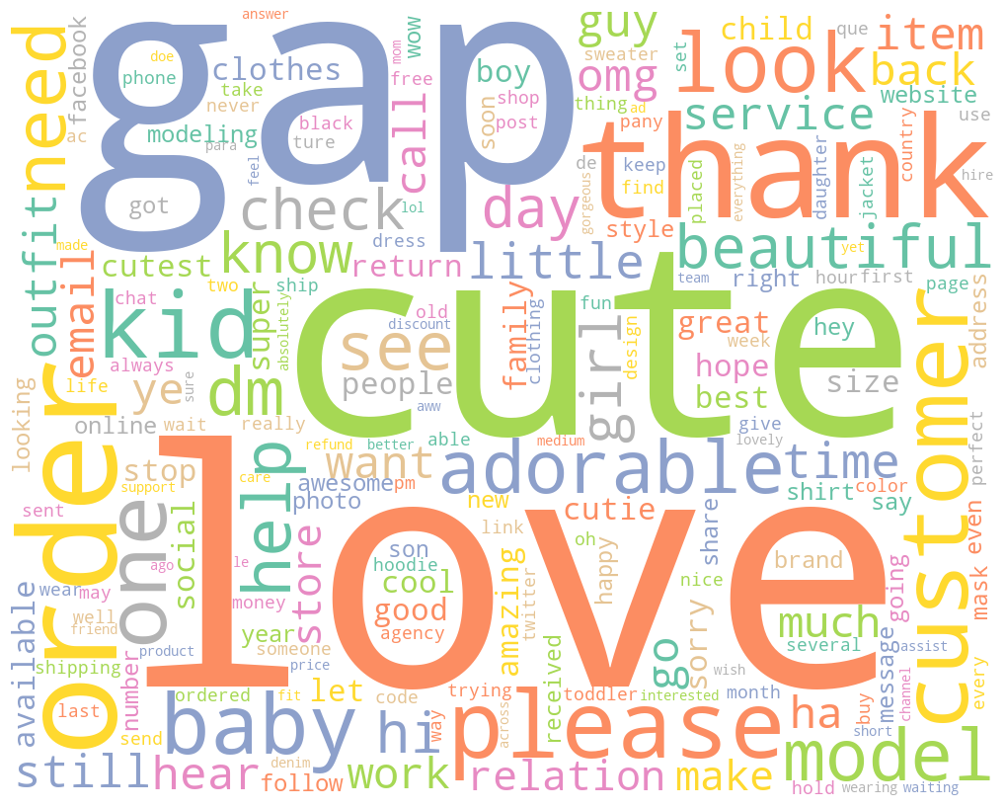
WORD FREQUENCY - Instagram
10 most frequent used words
Rank | Word | Frequency | Key Analysis
1 | love | 751 | Positive Sentiment
2 | gap | 580 | Brand Engagement & Awareness
3 | cute | 566 | Positive Sentiment
4 | get | 299 | Purchase Intent & Customer Service
5 | order | 297 | Focus on Demographics
6 | please | 239 | Purchase Intent & Customer Service
7 | customer | 238 | Purchase Intent & Customer Service
8 | kid | 222 | Product Focus
9 | one | 195 | Purchase Intent & Customer Service
10 | thank | 193 | Gratitude, appreciation, satisfaction
7,331

Slide 22

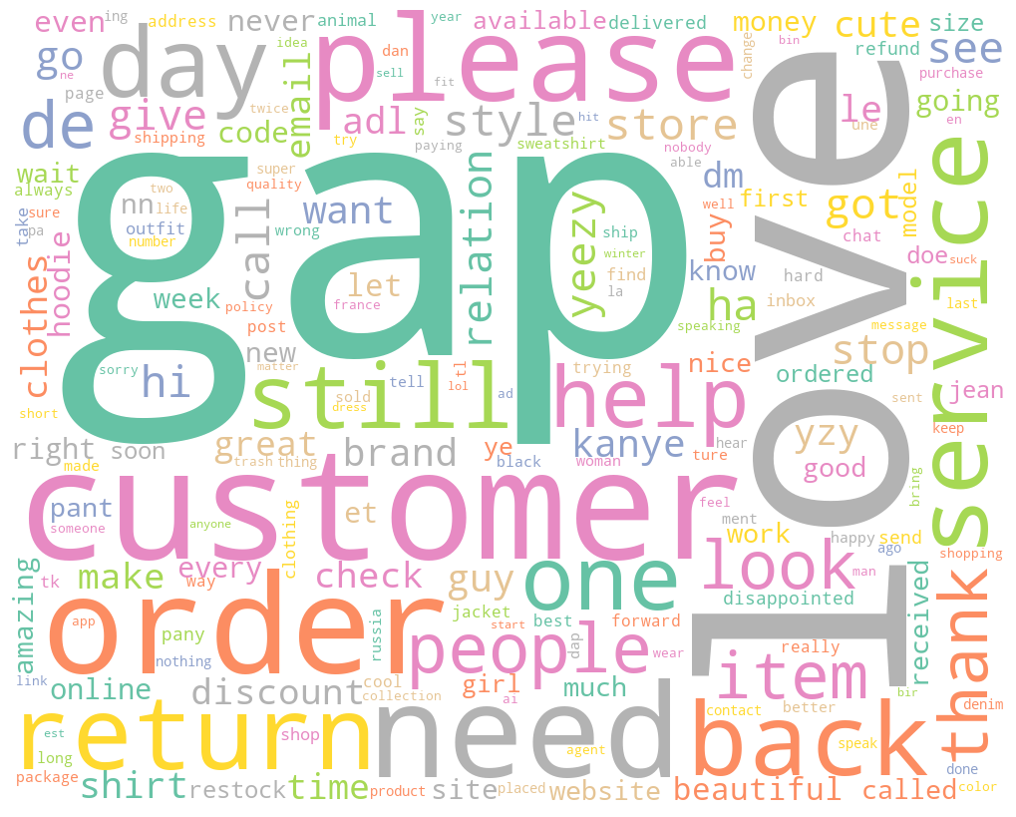
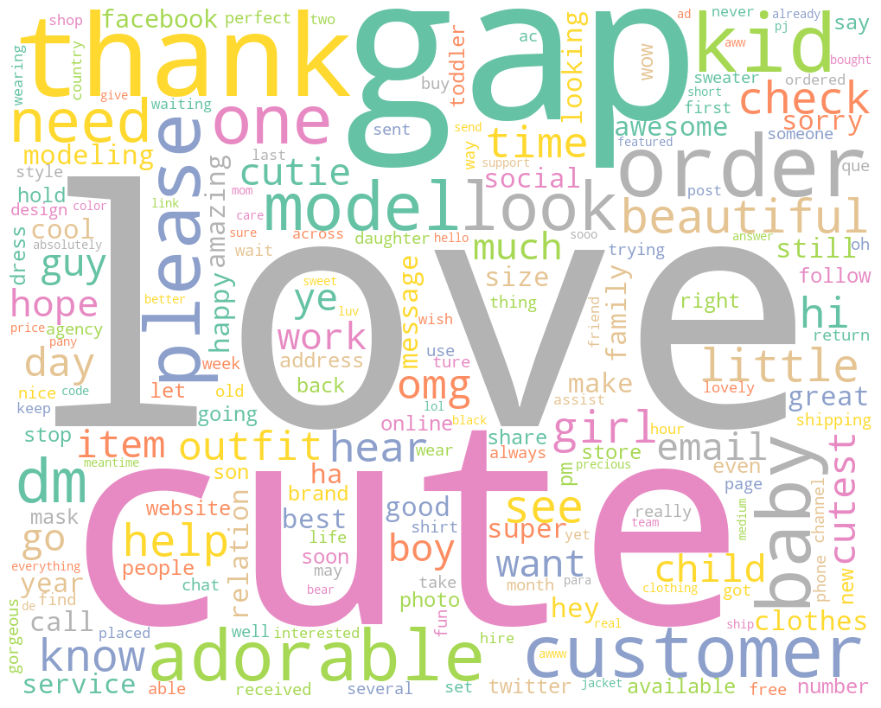

WORD FREQUENCY - Instagram
gap
2,370
4,961
customer

Slide 23
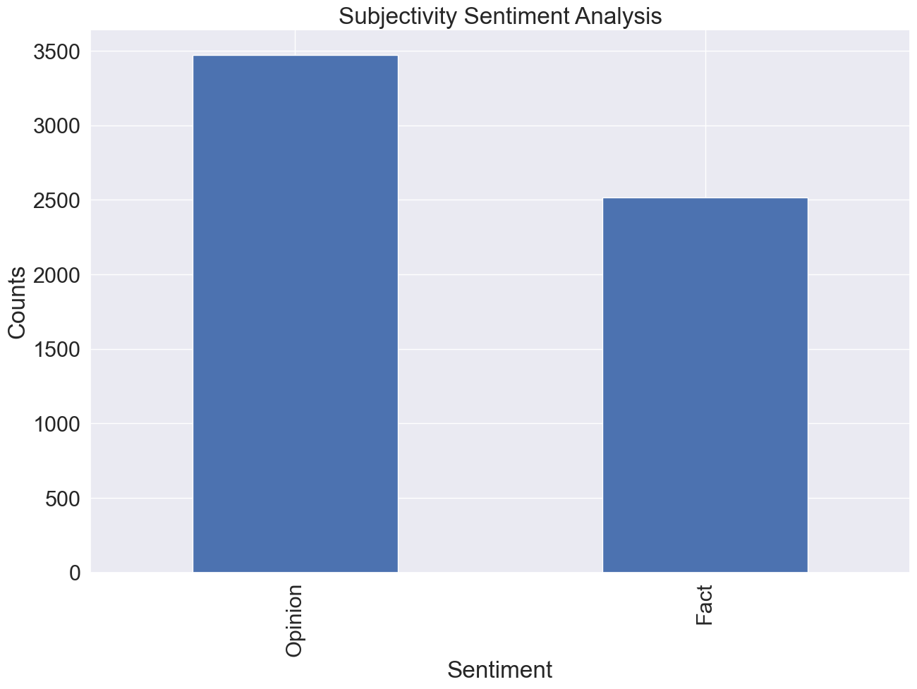
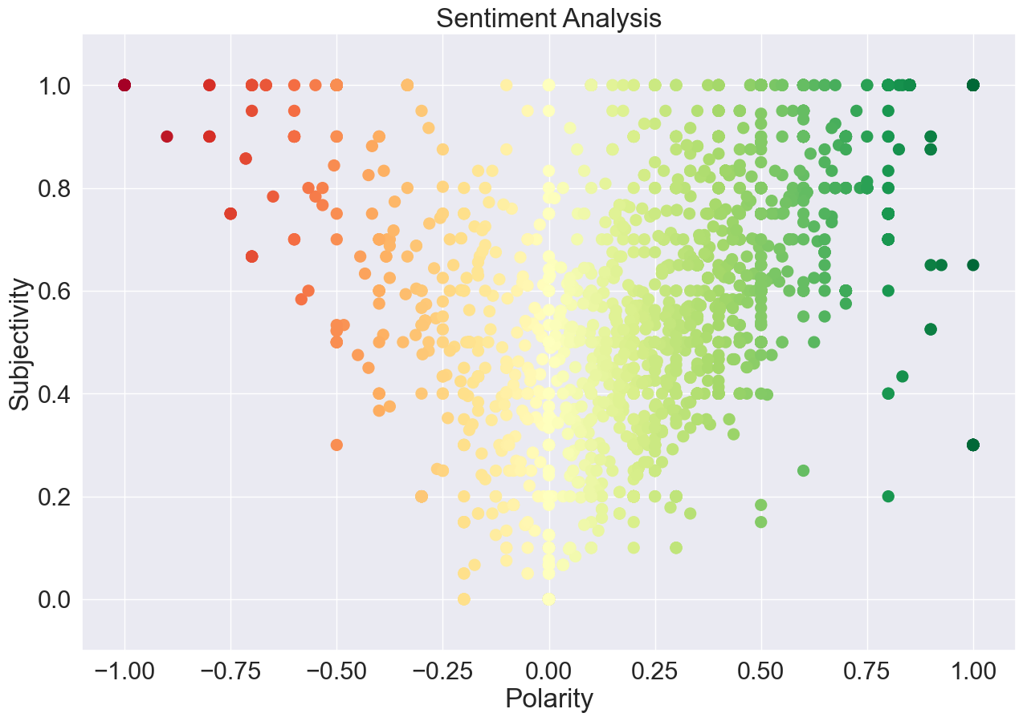
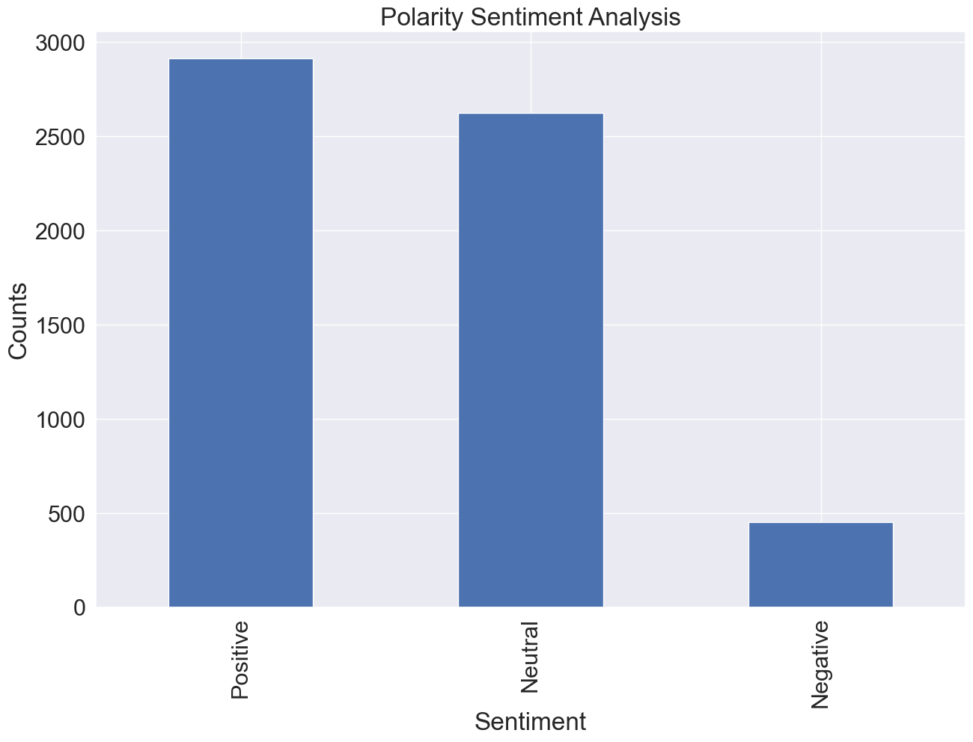

SENTIMENT ANALYSIS - Instagram
3 types used in this study:​
58% Opinions
3,470 expressing opinions ​
2,516 expressing facts ​
2,912 Positive 2,624 Neutral
450 Negative​
49%
Subjectivity float range: [0, 1]​
The Polarity float range: [-1, 1]

Slide 24
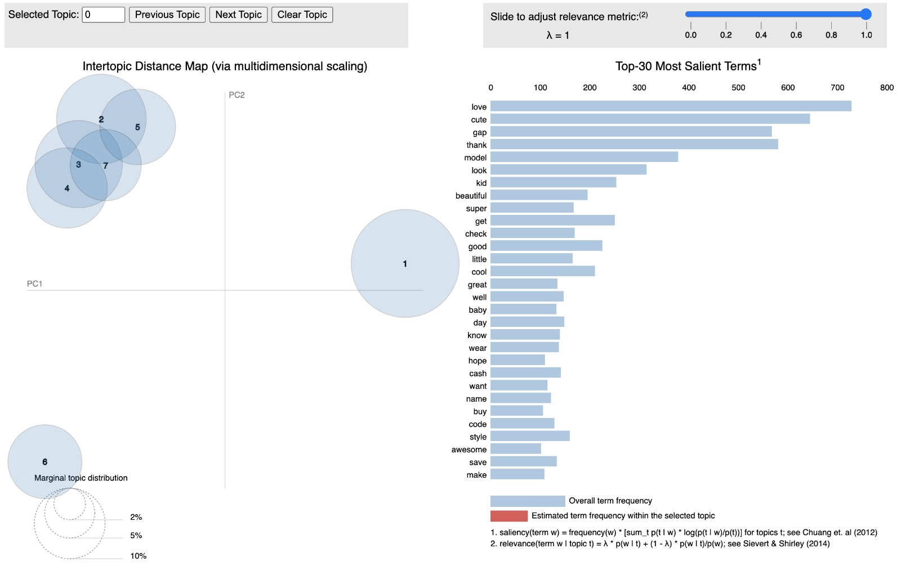
TOPIC MODELING AND SENTIMENT LABELING
7 Topics, based on the words:
https://radimrehurek.com/gensim/auto_examples/tutorials/run_lda.html#sphx-glr-auto-examples-tutorials-run-lda-py

Slide 25
GAP Instagram - SUMMARY
Content Strategy
GAP Kids has a more active content strategy, with 719 posts compared to GAP Adults' 224 posts. The higher posting frequency can lead to increased visibility and interaction, contributing to higher engagement.
Target Audience Behavior
Parents, who are the primary audience for GAP Kids, are likely to be more active on social media, seeking inspiration, sharing experiences, or connecting with other parents. This could lead to a more engaged audience for GAP Kids
compared to GAP Adults, even with fewer followers.
Content Appeal and Shareability
GAP Kids' content may have a broader appeal due to its focus on children, often featuring cute or funny moments that resonate emotionally with users. This can lead to increased sharing, comments, and overall engagement.
GAP Kids outperforms GAP Adults in engagement despite fewer followers

Slide 26
Canadian Market
Domain Keyword Rankings and Keyword Gap
Missing Keywords, Weak Keywords, and Search Intent
Competition Based on Keywords and Traffic
SEMRUSH ANALYSIS

Slide 27
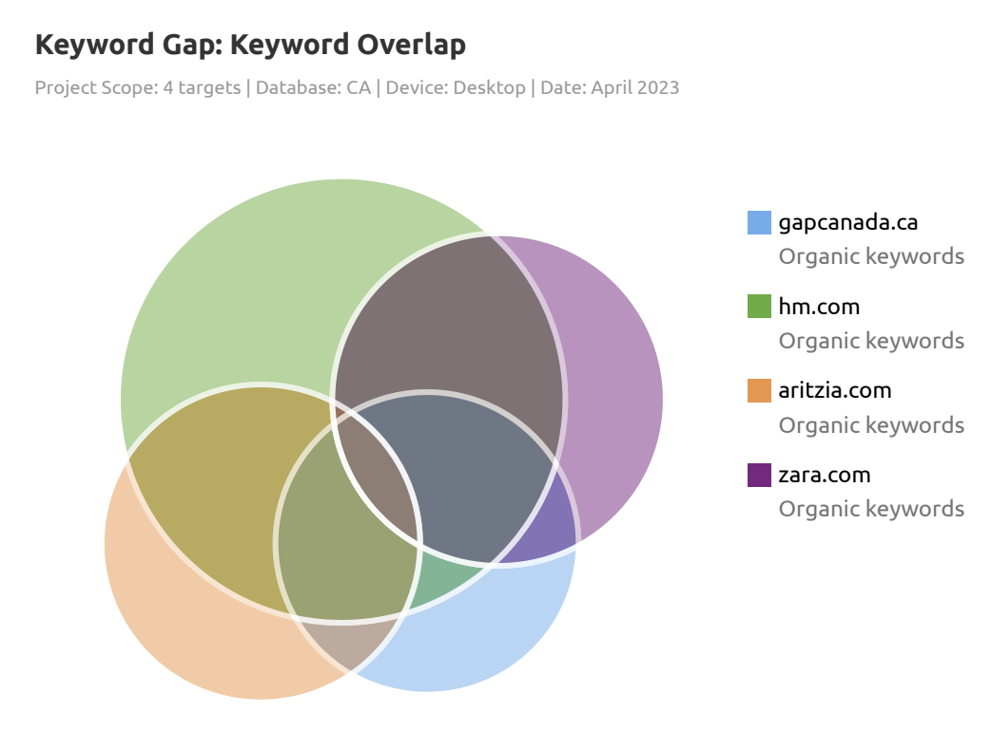
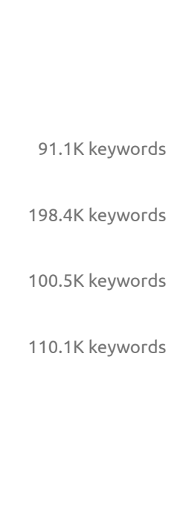
DOMAIN KEYWORD RANKINGS & GAP
Top-ranking keywords
Cashmere polo
Old navy plaid jacket
Banana republic near me
Organic keywords comparison
Gap Canada, H&M, Aritzia, Zara
Importance of top SERP rankings
Increased visibility and traffic
Refining Gap's SEO strategy
Learn from competitors' success.

Slide 28
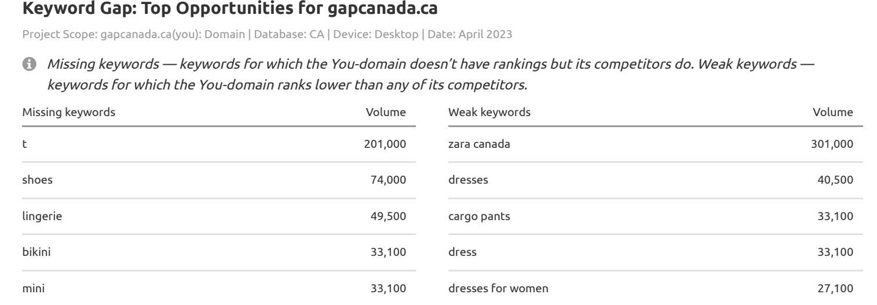
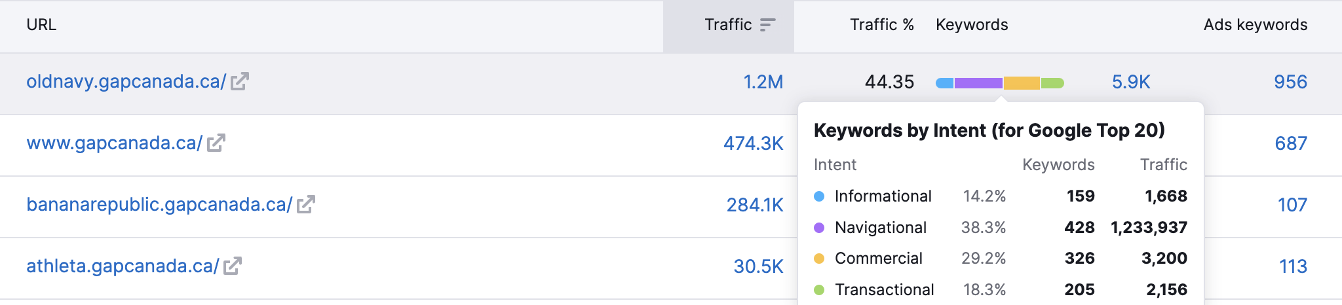
MISSING,WEAK KEYWORDS & SEARCH INTENT
Identifying missing and weak keywords
Enhancing search visibility
Examples: t, shoes, lingerie, bikini, mini.
Comprehending search intent types
Informational, navigational, commercial and transactional
Examining Old Navy's keyword distribution by intent
Insights for content optimization strategy

Slide 29
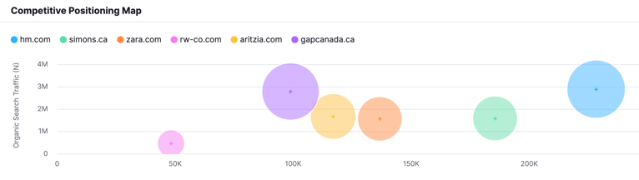
COMPETITION BASED ON KEYWORDS & TRAFFIC
Market leaders: H&M and Gap
Lower visibility competitors: Aritzia, Simons. CA, Zara, RW&CO
Gaining insights from market leaders' success:
Effective keyword targeting and content optimization
User experience and website performance optimization
Leveraging social media, local SEO, and other marketing channels for increased exposure

Slide 30
Recommendations

Slide 31
RECOMMENDATIONS
Boost social media presence and use social media analytics integrated with CRM
User Experience & Engagement
Product Strategy & Messaging
Optimize content and SEO for improved search visibility
Customize content and partner with influencers to increase brand reach
Social Media & Online Presence
Ensure seamless website experience and diversify content
Use email marketing to increase transactional intent
Align messaging with customer needs and optimize product offerings
Market Research & Analysis
Monitor public opinion using sentiment analysis tools and analyze popular products/subsidiaries for detailed insights

Slide 32
Conclusion

Slide 33
CONCLUSIONS
• The literature review highlights the need for strong digital media presence for retail brands to remain competitive.
• Sentiment analysis identified need for separate analyses and strategies for GAP and GAP Kids.
• Comments analyzed were mostly and Top 5 words in YouTube comments were positive.
• Topic modeling revealed seven areas of interest for GAP's social media audience.
• SEMrush analyzed GAP Canada's website, found SEO and content optimization opportunities to compete with H&M.
• Overall, this study will help GAP improve digital media presence and performance by understanding customer preferences and engagement factors.

Slide 34
Thank YOU!!!

Slide 35
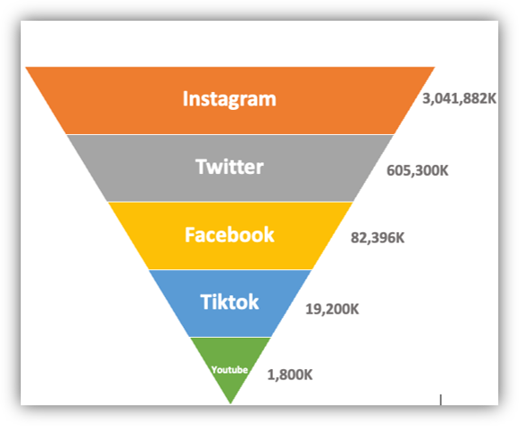
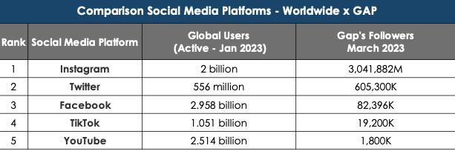
OVERVIEW - SOCIAL
Datareportal. (2023, January). Digital 2022: Global overview report. Retrieved April 5, 2023, from https://datareportal.com/social-media-users + GAP SOCIAL MEDIA ACCOUNT, Retrieved April 5, 2023

